Slide 1
WARNING
This collection of slides provides an idea of the course structure and key words.
It is NOT intended to substitute the readings required by the instructor.

Slide 2
TCH401 FINANCIAL MARKETS AND INSTITUTIONS Nguyen Manh Hiep 2021

Slide 3
CHAPTER 1 INTRODUCTION

Slide 4
In this chapter:
I.
THE FINANCIAL SYSTEM
II.
FINANCIAL MARKETS
III.
FINANCIAL INSTITUTIONS
V
FUN PUZZLES
IV.
LAW OF ONE PRICE

Slide 5
GUIDE TO TCH401
Go to the website. Download the reference guide. Read and understand the readings.
Ask questions in class or by email. Arrange rendezvous with the instructor if needed.
Mid-term 40%: daily oral tests, in-class performance, mid-term paper test(s). Final-term 60%: paper test.
Historical statistics: Grade A ~ 5%, B ~ 25%. C ~25%. D ~25%. F ~20%.

Slide 6
I. THE FINANCIAL SYSTEM
The Financial System
Public Finance
Financial Market
Financial Institutions
Business Finance
Personal Finance

Slide 7
I. THE FINANCIAL SYSTEM
Empirical researches have shown a positive correlation between the size, depth and sophistication of the financial system and GDP growth rate. (Refer: Rajan, Zingales: Financial Independence and Growth, The American Economic Review, 1998)
In both developed and emerging countries, financial crises have time to time slowed down the economic growth and they have long-lasting effects. (Refer: Cecchetti, Kohler, Upper: Financial Crises and Economic Activity, BIS working paper, 2009)

Slide 8
I. THE FINANCIAL SYSTEM
Public Finance (TCH431)
Government operations to implement policy.
Efficient resources allocation, income distribution and economic stabilization.
Business Finance (TCH321)
Business operations to maximize owner’s wealth.
Investing and financing decisions.
Personal Finance (TCH405)
Individual or family activities.
Maximize utilities.

Slide 9
I. THE FINANCIAL SYSTEM
Internal Finance: Reinvest the cash-flows generated within the families, firms...
External Finance: Ones with budget deficits seek for outside sources of capital from those with budget surpluses by the means of direct finance and indirect finance.

Slide 10
I. THE FINANCIAL SYSTEM
Direct finance: borrowers issue securities to borrow funds directly from the lenders.
Indirect finance: financial intermediaries channel funds from lenders to borrowers.
(Reference: Mishkin 9th, Chapter 2)
Function: Channels and allocates funds efficiently from savers to spenders, across economic sectors and geographical areas.

Slide 11
I. THE FINANCIAL SYSTEM
Example:
More developed financial systems utilize more external funds.
In the U.S., external funds finance around 50% of investments.
In Vietnam, the number is somewhere less than 20%.

Slide 12
I. THE FINANCIAL SYSTEM
Example
Large firms use more external funding.
(Source: WB)

Slide 13
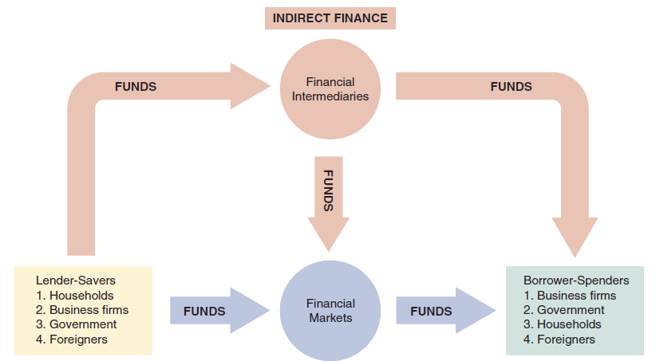
I. THE FINANCIAL SYSTEM
Capital Movements in the Financial System
(Refer: Mishkin 9th Chapter 2)

Slide 14
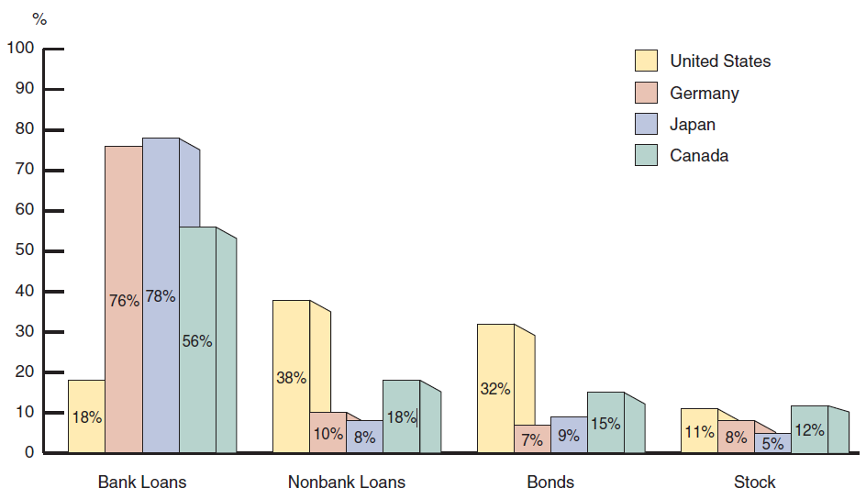
I. THE FINANCIAL SYSTEM
Sources of External Funds for Nonfinancial Businesses (Refer: Mishkin 9th Chapter 7)

Slide 15
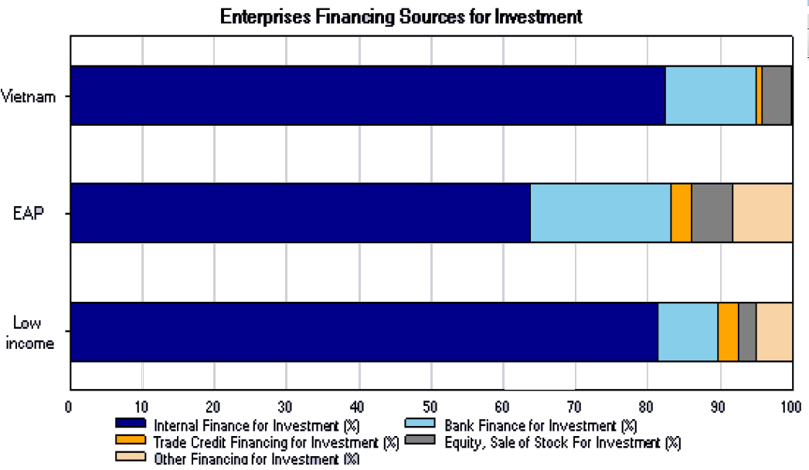
I. THE FINANCIAL SYSTEM
Sources of External Funds (Vietnam) (Source: WB)

Slide 16
I. THE FINANCIAL SYSTEM
Sources of External Funding
(Source: WB)

Slide 17
I. THE FINANCIAL SYSTEM
The economies usually emphasize either direct finance or indirect finance thus they are called relationship-based/bank-dominated or arm’s-length/market-based financial systems.
Some think the distinction is unimportant to the growth of the economy. (Refer: Beck 2003, Financial Dependence and International Trade, Review of International Economics)

Slide 18
I. THE FINANCIAL SYSTEM
Some say it is important. For example:
Bank-dominated system is more advantageous in financing physical-asset-intensive industries and more suitable for developed economies while
Market-based has comparative advantage in financing high-tech R&D-based industries with intangible assets and more suitable for underdeveloped economies.
(Rajan, Zingales: Financial System, Industrial Structure, and Growth, Oxford Review of Economic Policy, 2001)

Slide 19
I. THE FINANCIAL SYSTEM
Financial Assets
Are vehicles for transferring funds.
They are legal contracts which associate gains and losses for the parties with the actual occurrence of uncertain events.
(Reference: Mishkin 9th, Chapter 7)

Slide 20
I. THE FINANCIAL SYSTEM
Laws and Regulations
Important for the design, efficiency, stability and innovation of the financial system. (Porta, Silanes, Shleifer, Vishny 1998, Law and Finance, Journal of Political Economy)
Religious law: Islamic law sets legal framework for Islamic banking.
Positive law: Common law and Civil law.
Bankruptcy law, tax law, other regulations and supervision authorities are important. (how?)

Slide 21
II. FINANCIAL MARKETS
Financial markets are factor markets (capital).
Function
Channel funds from saving to investment.
Determine prices of financial instruments.
Reduce information cost, search cost.
Create liquidity.
Government implements its economic policy.
(Refer: Mishkin 9th Chapter 2; Madura 9th Chapter 1)

Slide 22
II. FINANCIAL MARKETS
Qualities of Financial Markets
Transparency.
Liquidity.
Assurity of completion.

Slide 23
II. FINANCIAL MARKETS
Characteristics of a Liquid Market
Low bid-ask spreads.
Deep.
Resilient.
Factors Contributing to Market Liquidity
Many buyers and sellers.
Diversity of participants (opinions, information, needs…).
Convenience.
Integrity.

Slide 24
II. FINANCIAL MARKETS
The Cost of Trading Components
Explicit costs (broker commission, taxes, fees,…)
The bid-ask spread.
Market (price) impact. Implicit costs
Missed trade opportunity costs.
Delay costs.
(Refer: CFAI 2020 Level 3 Volume 6 SS16)
Wagner, Edward, 1993, Best Execution, Financial Analyst Journal.

Slide 25
II. FINANCIAL MARKETS
Example of the Cost Components
1/1 the stock price for ABC closes at $20.
2/1 Phuong Xuan decides to submit a buy limit order for 100 shares of ABC at $19.75. During the day, the price never falls to $19.75 and closes at $20.05.
3/1 Phuong Xuan submit a buy limit order for 100 ABC shares at $20.06. Only 80 shares are bought at $20.06, order for the remaining 20 shares is cancelled. The commissions and fees are $2. The stock closes at $20.1.

Slide 26
II. FINANCIAL MARKETS
Example: the Cost Components: Implementation Shortfall Method
Cost if buy 100 at 1/1: 100*$20. Portfolio value at 3/1: 100*$20.1. Gain $10.
Actual gain (80*$20.1)–(80*$20.06+$2)=$1.2.
Imp. Shortfall=(10-1.2)/2000=0.44%.

Slide 27
II. FINANCIAL MARKETS
Example: the Cost Components: Implementation Shortfall Method (cont’)
Explicit costs = 2/2000 = 0.1%.
Realized profit/loss
((20.06-20.05)/20)*(80/100)=0.04%
Delay costs
((20.05-20)/20)*(80/100)=0.2%
Missed trade opportunity cost
((20.1-20)/20)*(20/100)=0.1%.
Total: 0.44% = implementation shortfall

Slide 28
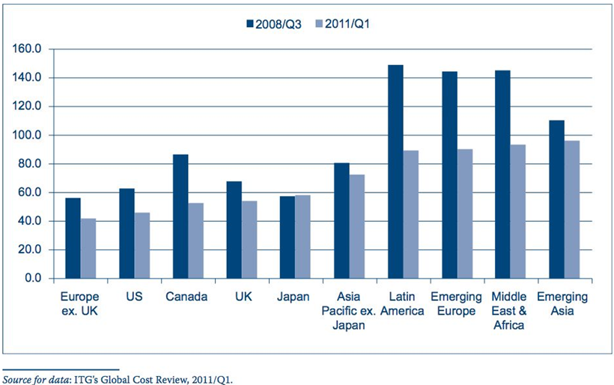
II. FINANCIAL MARKETS
Global Equity Trading Costs (basis points) (CFA Curriculum)

Slide 29
II. FINANCIAL MARKETS
Types of Traders
Information-motivated traders.
Value-motivated traders.
Liquidity-motivated traders.
Passive traders.
Dealers.
Day traders.

Slide 30
II. FINANCIAL MARKETS
Financial Market Structure
Monetary markets and Capital markets.
Debt markets and Equity markets.
Primary markets and Secondary markets.
Exchanges and Over-the-counter markets.
(Refer: Mishkin 9th Chapter 2)

Slide 31
III. FINANCIAL INSTITUTIONS
Shortcomings of Direct Finance
Transaction costs.
Asymmetric information: adverse selection and moral hazard. (How financial intermediaries overcome those problems?)
(Refer: Mishkin 9th Chapter 7)
Akerlof, 1970, The Market for “Lemons”: Quality Uncertainty and the Market Mechanism, Quarterly Journal of Economics.
Benston, Smith, 1977, A Transaction Cost Approach to the Theory of Financial Intermediation, Journal of Finance.
Diamond, 1984, Financial Intermediation and Delegated Mornitoring, Review of Economic Studies.
Scholtens, Wensveen, 2000, A Critique on the Theory of Financial Intermediation, Journal of Banking and Finance.

Slide 32
III. FINANCIAL INSTITUTIONS
Mai Linh Café
Mai Linh owns a Café on D5 Street. Last Christmas she and her boyfriend broke up. She was sad and decided to to study an MBA at US. An investor has proposed to buy her Café at anytime (today or next year) at VND20 billion. Mai Linh can borrow at 10% interest rate. Mai Linh now has 2 choice:
Sell the Café immediately, PV = VND20 billion.
Hire a manager and redesign the Café at the cost of VND5 billion, for a profit of VND10 billion at the end of the year. PV = 22.3 billion.
Mai Linh need VND6 billion this year for tuition fee and the living expense in the US. What should she do?

Slide 33
III. FINANCIAL INSTITUTIONS
Bernard Madoff Ponzi Scheme
Bernard Madoff managed a $65 billion fund.
17 years of continual high return (10-15%).
Attract many investors.
Dec 11th 2008 arrested.
Audit problem.
What is the role of asymmetric information in this case?
(Refer: Mishkin 9th Chapter 2)

Slide 34
III. FINANCIAL INSTITUTIONS
Types of Financial Institutions
Depository Institutions
Contractual Savings Institutions
Investment Intermediaries
(Refer: Mishkin 9th Chapter 2)
Fama, 1985, What’s Different about Banks? Journal of Monetary Economics.

Slide 35
III. FINANCIAL INSTITUTIONS
Example
Differences between commercial banks and insurance companies
Sources of fund
Uses of fund
Liquidity need

Slide 36
III. FINANCIAL INSTITUTIONS
Convergence in the Financial System
Between markets and institutions
Among institutions
Among national systems
Banking and insurance regulation and supervision: Greater convergence, common challenges (bis.org) (Ctrl+Click to follow link)

Slide 37
IV. LAW OF ONE PRICE
Law of One Price
A $1000 par, 1 year to maturity discount bond is selling at $940. Mai Linh can borrow from the bank at 5% interest rate. Can Mai Linh take advantage of this situation?

Slide 38
IV. LAW OF ONE PRICE
Law of One Price
Stock A: current market price $100, expected to be $140 in 1 year if the economy is good (prob. 50%) or $80 in case of downturn (50%).
Stock B: price in 1 year is expected to be $60 in case of good economic condition and $0 in case of downturn.
One-year treasury bill market rate 4%.
What should be the price of stock B if the Law of One Price holds?

Slide 39
IV. LAW OF ONE PRICE
Law of One Price
Stock A: current market price $100, expected to be $140 in 1 year if the economy is good (prob. 50%) or $80 in case of downturn (50%).
Stock B: price in 1 year is expected to be $0 in case of good economic condition and $60 in case of downturn.
One-year treasury bill market rate 4%.
What should be the current market price of stock B if the Law of One Price holds?

Slide 40
IV. LAW OF ONE PRICE
Law of One Price
$1000 par 1-year discount note.
Bank deposit interest rate 6%.
Bank loan rate 6.5%.
What happens if note price higher than $943.4 or lower than $938.97?
What happens if note price is between $938.87 and $943.4?

Slide 41
V. HOMEWORK
How can a firm raise fund from informal finance? Why does informal finance exist? Find the answer with Allend2009 and Burkhart2004.
Is crowdfunding direct finance or indirect finance? What are the main types of crowdfunding? What are the risks to investors? Find the answer with Dunkley2016, Powell2019, Johan2020, BelleFlamme2014.
Read McCauley2021 and explain why the author thinks Bitcoin is worse than a Ponzi Scheme? Do you agree? Elaborate your opinion.

Slide 42
V. HOMEWORK
4. Based on Zetzche2020 and BIS2023, what is DeFi and what are the risks DeFi poses to the financial system?
5. Based on IFFEY2022, what are the benefits of Machine Learning in risk management in financial institutions?

Slide 43
End of Chapter 1

